Slide 1
Week 16 – AP Macroeconomics

Slide 2
Money Markets and Monetary Policy
This is perhaps the most important topic of Unit 4: Monetary Policy.
The coverage of AD/AS, Fiscal Policy and now Monetary Policy is the foundation of AP Macro.

Slide 3
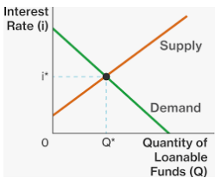
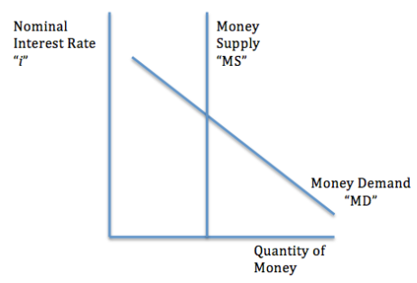
Two types of money market.
Money Market
Shows how people demand cash and liquid money (M1) to be used primarily for transactions
Loanable Funds Market
Shows how people want to lend/borrow money for long term investments

Slide 4
Money Market
We can also call this model the Liquidity Preference Model because it shows how people choose between having liquid money and earning interest.

Slide 5
Revision: Opportunity Cost of Liquid Money
We established that the time value of money is where money increases in value over time by earning interest/returns.
Another way of looking at the time value of money is through opportunity cost.
The opportunity cost of holding or using money, is the interest you could have earned by investing it.
Option 1:
Keep money in your Wechat pay account with 0% interest and use it to buy various things.
Option 2:
Keep money in an interest bearing account which pays 3% per year.
Summary
Holding money has an opportunity cost of the interest you could have earned by putting in a savings account/investing.
Opportunity Cost of Option 1 is the benefits of Option 2 ie. The 3% interest.

Slide 6
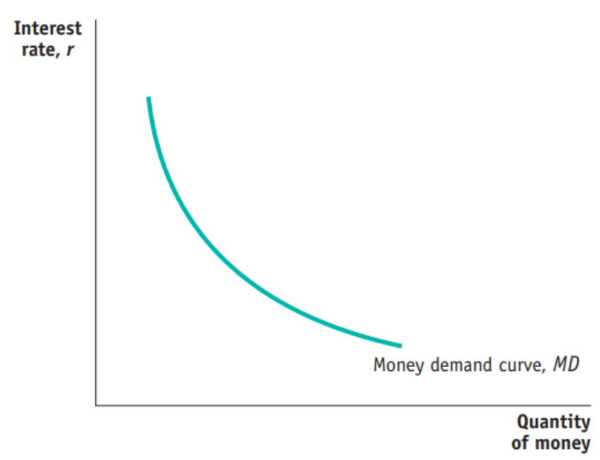
Money Market / Liquidity Preference Model
Money demand / Liquidity preference refers to the choice of holding money versus saving it elsewhere. (Liquidity = cash, eg. converting a house to cash by selling)
Note: This money is M1, liquid money.
Reasons to hold money
transactions (consumption)
As an asset
precaution
Remember: The cost of holding money is the nominal interest rate, ie. the interest that you give up.
You do not receive interest when you hold cash or keep money in checking accounts.
(Interest is also the reward for not holding liquid money.)
These are high value users; people who want to hold liquid money even if they give up a lot of interest.
Nominal
6%
As the interest rate falls, the Cost of holding liquid money falls because people aren’t giving up as much interest.
More people will hold liquid money.
1%
Summary
The demand for liquid money is for transactions and to hold as an asset.
There is a negative relationship between interest rate and money held.
(M1)

Slide 7






Reasons to Hold Money
Summary
M1 money is held for 3 reasons: Transactions, as an Asset, as a precaution.
The need for M1 money in transactions means that demand for money is linked to Aggregate Demand.
Transactions
This is self explanatory. Liquid money is needed to buy things.
This includes all expenditure within the economy, namely
C, I, G, X-M
Therefore, holding M1 money is very much linked to Aggregate Demand!
Asset
Money, like any asset can go up or down in value.
Some investors speculate on the prices of various currencies. They can earn profit if they can correctly predict whether the value of an asset goes up or down.
Example: Buy 100 USD for 680RMB, then later sell $100 USD for 720RMB. In this case you have made 40RMB profit!)

Slide 8


Reasons to Hold Money continued…
Precaution
This is a relatively minor category, however many people store small amounts of cash for certain emergency situations.
Eg. Many people keep some extra money in their wallet.
Many people keep extra money in their house in a safe place.

Slide 9
What are two reasons that people will hold liquid money?
Transactions – to buy things
As an asset (less common reason) – it may appreciate on the foreign exchange market for example.
For emergencies/as a precaution.
What is the relationship between the interest rate and the amount of liquid money held?
The lower the interest rate, the more people will prefer to hold liquid money because the cost of holding money is lower.
Therefore, inverse/negative relationship.

Slide 10
29. The opportunity cost of holding money is
the nominal interest rate on less liquid assets
the Policy Rate
the discount rate
the mortgage rate
zero
Answer: A
We will cover the Policy Rate and Discount Rate in the remainder of Unit 4

Slide 11
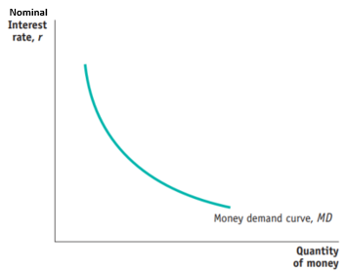
Draw the MD curve. Make sure to label the axes correctly.

Slide 12
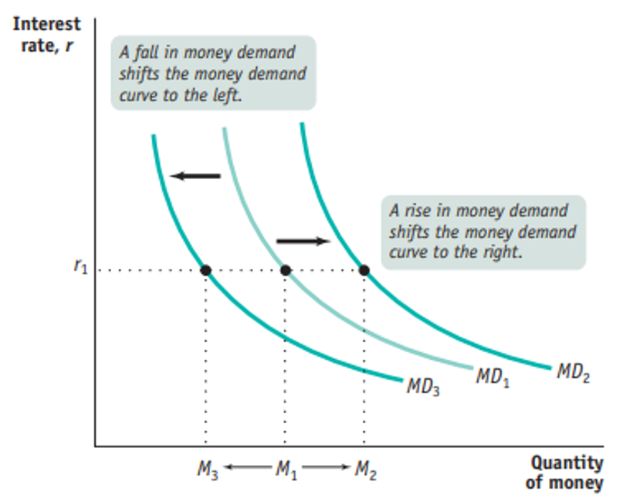
Shifters of Money Demand
Summary
Changes in price level, national income, technology or anything that changes AD will shift the MD curve.
The price level - When inflation occurs, people start demanding more money because the cost of living increases. As a result, the MD curve shifts to the right.
The national income level - An increase in the real GDP results in higher incomes. Consequently, people start demanding more money since their wealth increases.
Changes in banks technology – people can hold less liquid money because of online banking, so that money is converted to M1 money just as they make the purchase.
Important Note: Change in interest rate will move us up and down the same MD curve.
Increase in AD effect on MD
In order to buy goods and services liquid money is required. Therefore anything that will increase or decrease AD will also increase or decrease MD.

Slide 13
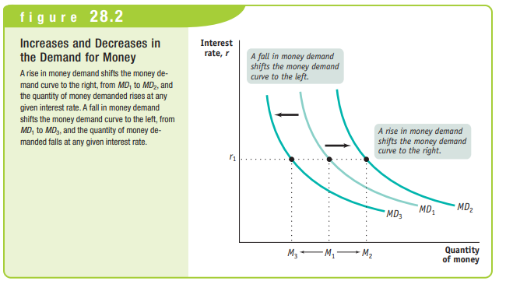

Slide 14
What are two things that could shift the MD curve to the right?
Increase in wealth – wealthier individuals spend more and will require more M1.
Increase in price level – people will have to spend more M1 to buy the same goods and services.
Increase in AD – this will increase real wealth and price level, causing people to need more M1.

Slide 15
Shift of Curve vs Movement Along the Same Curve
Remember that a movement along the same curve is NOT the same as a shift of the whole curve.
A change in the ‘quantity of money demanded’
This is a movement along the same curve
A change in the ‘Money Demand’
This is a shift of the whole curve

Slide 16
30. Why does the demand for money increase when national income increases?
The money supply increases
The budget deficit decreases
Interest rates increase
Spending on goods and services increases
Imports decrease
Answer: D
Remember that anything that increases AD will mean more expenditure which will mean more need for cash/M1 money.

Slide 17
31. How does an increase in price level affect the money market?
Money demand increases
Money demand decreases
Money demand does not change
Money supply decreases
Money supply increases
Answer: A
More money must be held to perform the same transactions.

Slide 18
32. An increase in the use of cell phones to provide electronic payment in stores will likely result in
an increase in money demand
a decrease in the money supply
an increase in nominal interest rates
a decrease in money demand
an increased opportunity cost for holding money
Answer: D
Less M1 money will need to be held before a transaction because M2 money can be converted closer to the transaction.

Slide 19
33. Assume that there are no fees to access an ATM. If Congress then decides to impose a $5 tax on each ATM transaction, what will be the likely effect?
The use of ATMs will increase
Money demand will decrease
Sellers will only accept cash as payment
Price level will increase
Money demand will increase
Answer: E
People will take out more money at once, therefore holding more cash overall.

Slide 20
34. How will households and firms react to an increase in the nominal interest rate for interest-bearing bank accounts?
The quantity of money demanded will increase
The quantity of money demanded will remain constant
The quantity of money demanded will decrease
The amount of money used for transactions will increase
The opportunity cost of holding money will decrease
Answer: C
People will prefer to keep their money in interest bearing accounts because they can earn more interest.
They will reduce the amount of money they hold.
(Note: this is a movement along the same curve, and not a shift of the entire MD curve.)

Slide 21
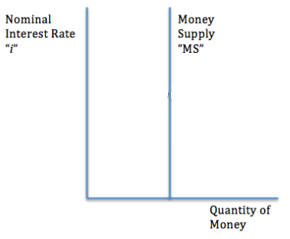
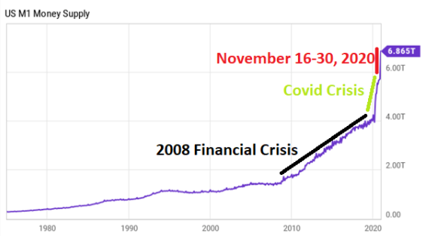
Money Market Supply
Summary
The money supply, MS is vertical because it is set by the Federal Reserve. The Fed will increase or decrease the money supply in different situations.
The money supply, MS, is set by the Central Bank/ Federal Reserve through their various policies and how much money is printed.
The MS determines how much money people have access to.
Because the Federal Reserve is a non-profit organization, it will not seek additional profit when the interest rate is higher.
Therefore we can assume that the supply curve, money supply curve, MS, is vertical.
Shifts of MS
Because the MS is controlled by the Fed, any increase or decrease in MS is also made by the Fed.
The Fed can choose to increase or decrease the money supply depending on the state of the economy.
Real World Money Supply Changes
In recent years the money supply has increased multiple times in response to recession type events.

Slide 22
Who determines the money supply?
The Federal Reserve.
Why is the money supply curve vertical?
Because it is controlled by the Federal Reserve. There is no relationship between interest rate and money supply.

Slide 23
Money Market Equilibrium
Summary
The money market shows demand and supply of liquid money.
Nominal interest is used because it is short term and has no expectations of inflation.
The MD and MS results in an equilibrium where MD = MS
Because the MS is vertical, the quantity of money will always be at the same level determined by the MS.
Nominal Interest Rate
However, the nominal interest rate ‘i’ will vary.
The reason that we use nominal interest for the Money Market is that it is based in the short run and there are no expectations about future change of price level ie. Inflation. Because we are not concerned with inflation, we are looking at the nominal interest rate.

Slide 24
What is the relationship between Quantity of money demanded and quantity of money supplied at the equilibrium?
Qd = Qs
Why do we use nominal interest rate with regards to the money market graph?
Because it concerns short term decision making, there is no consideration for future price level/inflation.

Slide 25
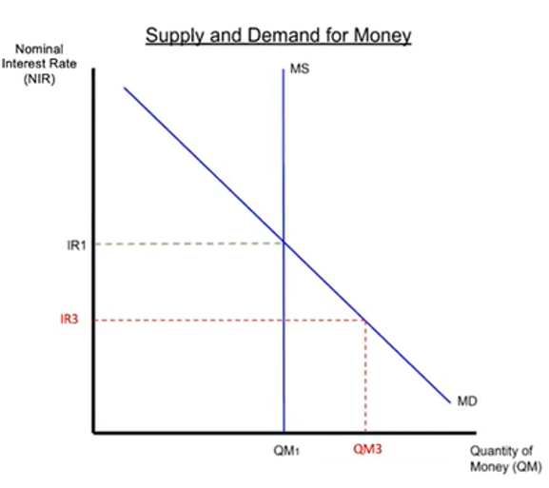
Market Adjustment – Surplus and Shortage
Summary
The market will naturally return to equilibrium where Qd=Qs.
Interest rate too high -> surplus -> IR will fall.
Interest rate too low -> shortage -> IR will increase.
Just like with all demand and supply, the market will return an equilibrium where Qd = Qs.
At higher interest rates, there will be a surplus of M1 money (Qs > Qd) Eventually lenders will decide to lower the interest rate and equilibrium will be restored.
At lower interest rates, there will be a shortage (Qd > Qs) which eventually will lead to a higher interest rate.

Slide 26
What happens if the nominal interest rate is higher than the equilibrium interest rate in the market for money?
There will be a surplus of M1 money (Qd<Qs), and eventually the interest rate will drop to the equilibrium interest rate.

Slide 27
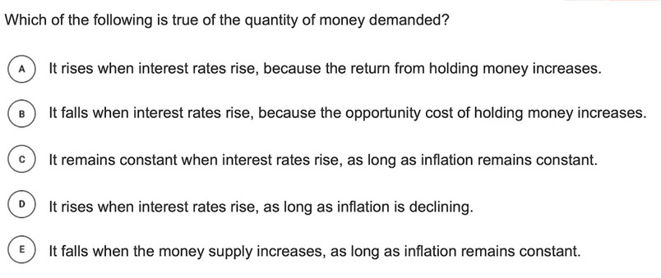
Answer: B

Slide 28
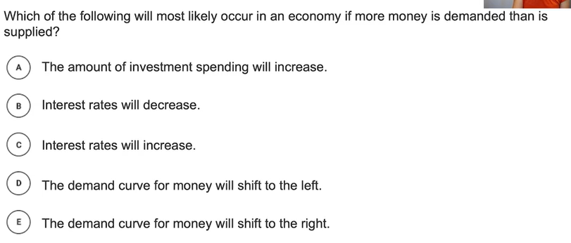
Answer: C

Slide 29

Money Market Summary
The money market models demand for and supply of M1
Equilibrium occurs when the nominal interest rate is such that the quantity of money demanded equals the quantity of money supplied.
NIR_{actual} = NIR_{equ} = Equilibrium (Qd = Qs)
NIR_{actual} < NIR_{equ} = Shortage (Qd > Qs)
NIR_{actual} > NIR_{equ} = Surplus (Qs > Qd)
NIR_{actual} < NIR_{equ} = Shortage (Qd > Qs)
Money Demand (MD)
The demand for money represents preferences for liquidity (M1) (money that can be used in transactions) and shows an inverse relationship between quantity and the nominal interest rate.
Factors that affect MD:
Price Level, National Income, AD, Banking Technology
Money Supply (MS)
The supply of money is independent of the nominal interest rate because it is controlled by the central bank.
Factors that affect MS:
We will soon see how the government can shift MS

Slide 30
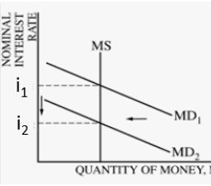
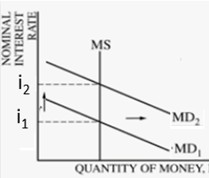
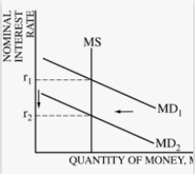
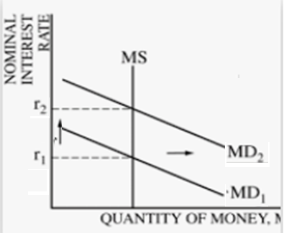
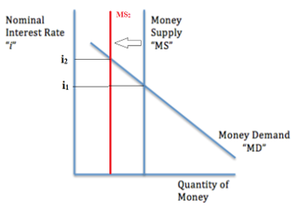
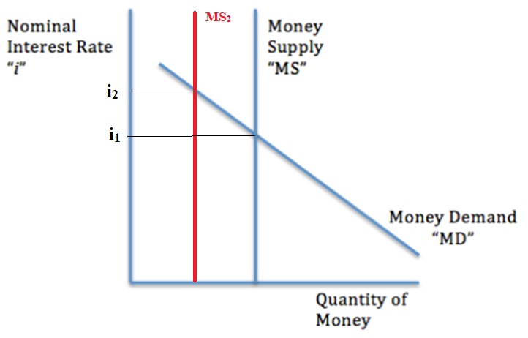
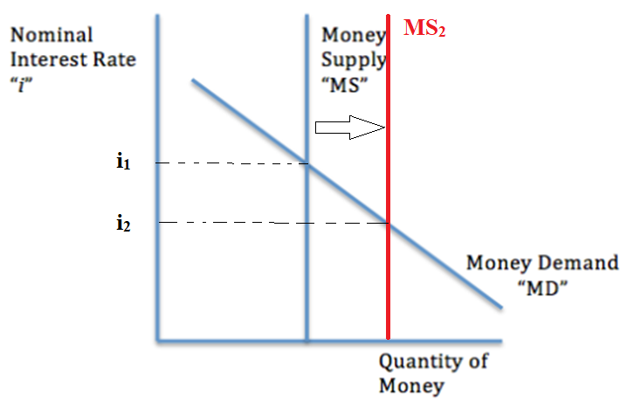
Change in Equilibrium
Equilibrium will change if either MD or MS changes.
Change in MD
Only affects the interest rate but not the quantity of money because of the vertical MS.
Change in the MS
Affects both the quantity of money and the nominal interest rate.
↓ MD→↓nominal interest
↑MD →↑ nominal interest
The change in nominal interest rate has significant consequences for the rest of the economy!
Hint: We briefly looked at monetary policy in previous classes. We will see how this
Summary
Changes in MD or MS will change the equilibrium.
There will be:
change in Nominal interest
and/or
change in Quantity of Money held
↓ MS→ ↑ nominal interest,
↓Quantity of Money
↑ MS→↓nominal interest,
↑ Quantity of Money

Slide 31
What happens in the money market if there is an increase in money supply, MS? Nominal Interest Rate? Quantity of money held?
Nominal Interest Rate will fall.
Quantity of money held will increase.

Slide 32
35 If the public decides to increase its holdings of currency, which of the following is most likely to increase?
bank deposits
investment spending
price level
the interest rate
the unemployment rate
Answer: D
This the result of increasing the MD.

Slide 33
36 Which of the following will most likely occur in an economy if the quantity of money demanded is greater than the quantity of money supplied?
The money demand curve will shift to the left
The money demand curve will shift to the right
Interest rates will increase
Interest rates will decrease
Excess reserves will decrease
IR_{equilibrium}
IR_{disequilibrium}
Answer: C
If the quantity of money demanded is greater than the quantity of money supplied then this means the IR is below the equilibrium rate.
The market will naturally adjust to equilibrium when (banks, bond markets etc.) increase the interest rate.
Q_{MS}
Q_{MD}

Slide 34
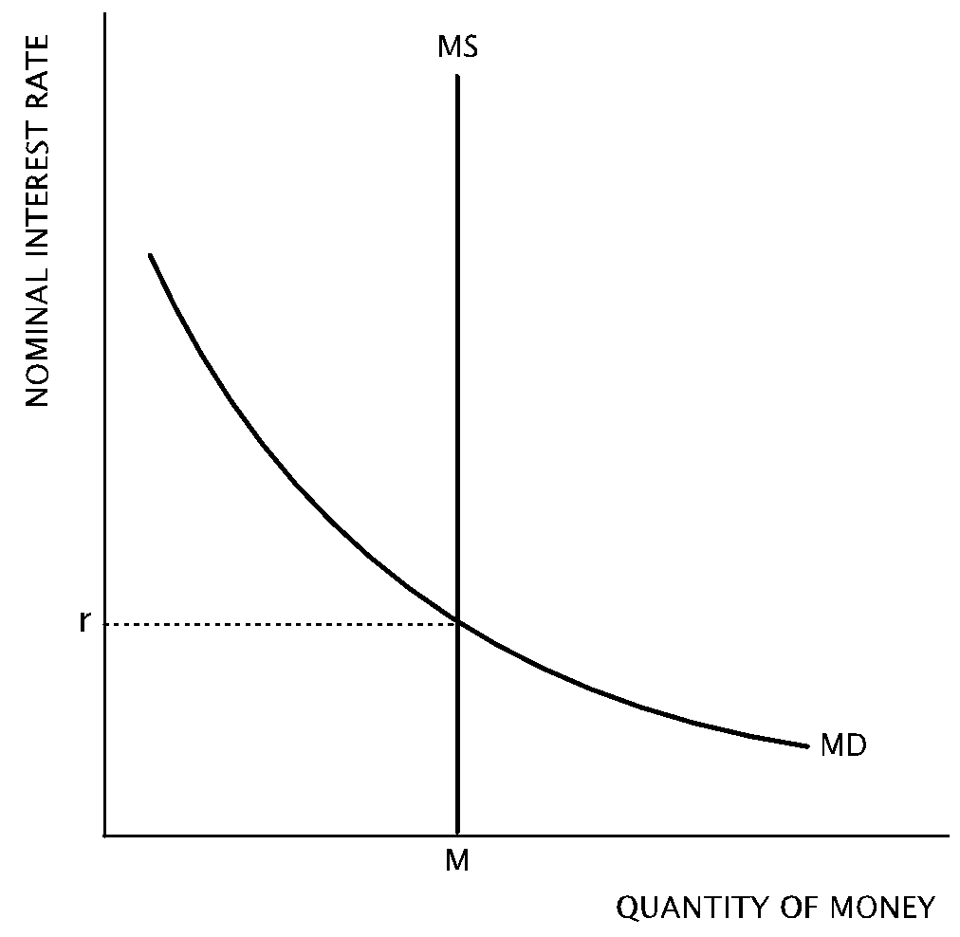
37 According to graph above, what is the likely result if there is an increase in the money supply?
the nominal interest rate will decrease
the nominal interest rate will increase
money demand will increase
the quantity of money demanded will decrease
the equilibrium quantity of money will decrease
Answer: A
The equilibrium nominal interest rate will be lower.

Slide 35
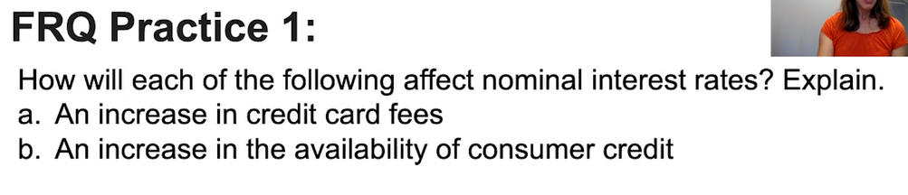
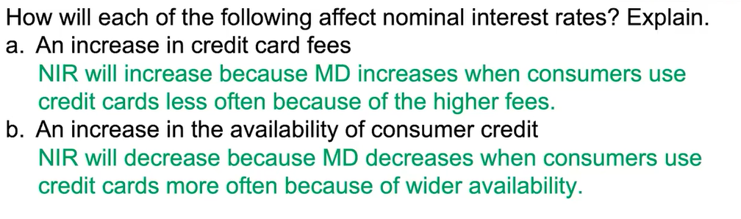

Slide 36
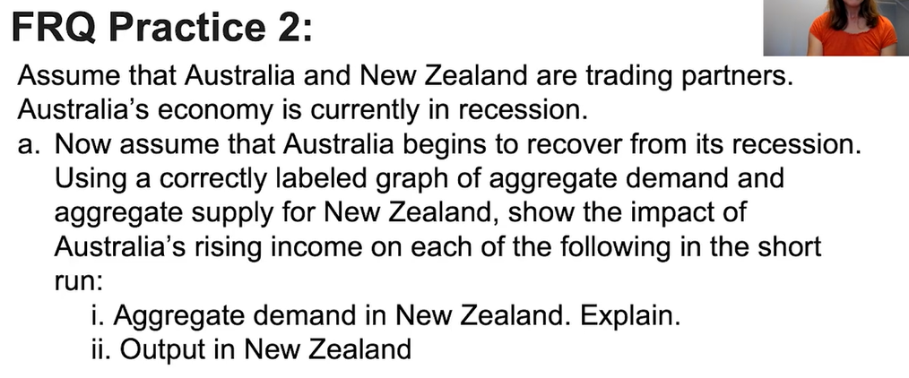
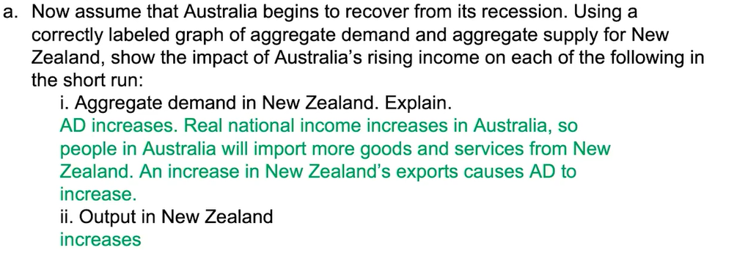

Slide 37
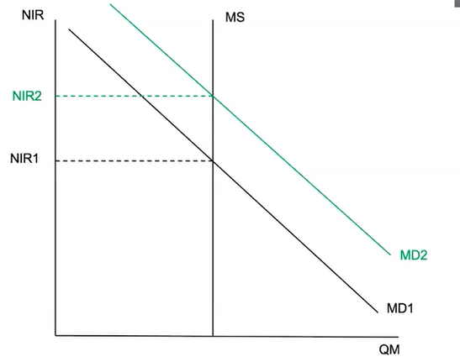
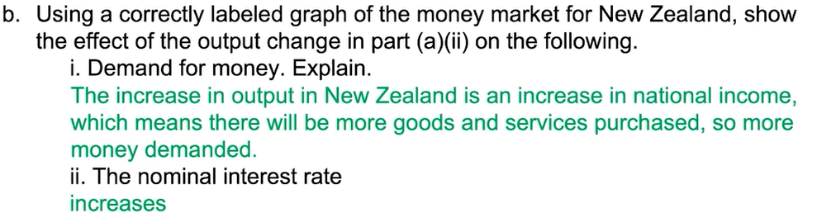

Slide 38
The Money Market and Monetary Policy

Slide 39
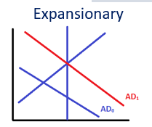
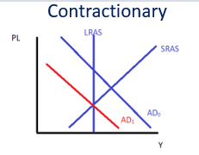
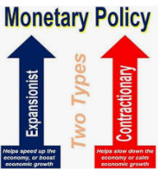
Monetary Policy Review
Monetary policy is the other main tool that the government can use to manage the economy. (What was the other one? Fiscal Policy)
Monetary Policy - Changing Interest Rates
We have now seen that MP is the changing of the interest rate by changing the money supply.
Changing the interest rate has the following consequence on the economy.
Investment (I) changes because the cost of borrowing is lower
Consumption (C) changes for interest sensitive products such as houses, cars, college tuition etc.
This leads to an increase or decrease in AD which can help fight a slowing economy which is in a negative output gap.
Fighting Recession / Correcting -ve output Gap
↑ money supply →↓ interest rate → ↑ AD
Note: The effect on the AD is the same as fiscal policy.
Fighting Inflation / Correcting +ve output Gap
Summary
Monetary Policy – ↑↓ money supply to ↓↑ the interest rate.
Expansionary – ↑ AD (correct –ve output gap)
Contractionary – ↓ AD (correct +ve output gap)
↓ money supply → ↑ interest rate → ↓ AD

Slide 40
What can the government do to interest rates to increase AD?
Lower interest rates which will increase consumption and investment
Is this expansionary of contractionary monetary policy?
Expansionary monetary policy
How can the government perform contractionary monetary policy?
Increasing the interest rates

Slide 41
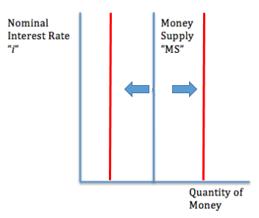
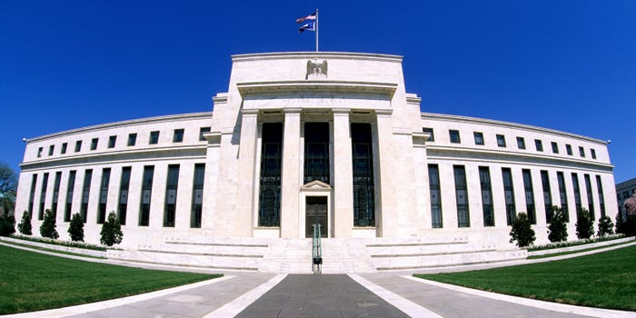
Central Bank Change of Money Supply
Summary
As we covered previously, the central bank (Federal Reserve in the US) can increase and decrease MS.
Hmmm… we need to increase the money supply…

Slide 42
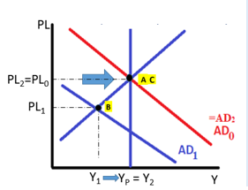
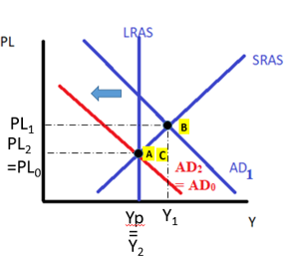
How the Money Market is Connected to Monetary Policy
Monetary policy is often conducted by changing the money supply which then changes the interest rate.
We will see how this occurs.
Summary
Monetary policy is often done by increasing or decreasing the money supply! This affects the interest rate which then affects AD.
The Central Bank Increases MS
↑MS→ ↓Nominal Interest Rates
→ ↓Cost of Borrowing
→ ↑Consumption↑ Investment
→ ↑ Aggregate Demand
The Central Bank Decreases MS
↓MS→↑Nominal Interest Rates
→↑Cost of Borrowing
→↓Consumption↓Investment
→↓Aggregate Demand
Expansionary Monetary Policy
Contractionary Monetary Policy

Slide 43
∆Money Supply -> ∆Interest Rate
Monetary Policy = Changing the Money Supply -> changing the interest rate
The change in money supply by the Fed causes the change in interest rate (not the other way around).

Slide 44
When the government increases the MS it has what effect on the IR?
Increase MS -> Decrease IR
What affect does this have on AD?
Increases AD due to more consumption and investment?
Which of these actions, increasing MS or decreasing IR is considered monetary policy?
Both. The change of IR is done by changing the MS. So they are both Monetary Policy.

Slide 45
What effect will a decrease of money supply have on the nominal interest rate?
Decrease MS -> Increase NIR
The economy is in a recession with high unemployment. What kind of monetary policy should be implemented?
Expansionary monetary policy.
What will the Fed have to do to the money supply and how will it help the economy?
The Federal Reserve will increase money supply.
This will lower the nominal interest rate and the cost of borrowing. Consumption and Investment will increase, resulting in a higher AD.
Using an AD/AS graph we can show that the economy will move back in the direction of Y_{p.}

Slide 46
If the government wishes to decrease AD, how could they do this with MS?
Decreasing AD would mean an increase of the IR which would require a decreasing of the MS.

Slide 47
What would the government need to do to the MS to have the same effect on AD as tax cut?
The government would have to increase the MS which would increase AD, the same as a tax cut.
Define both the actions in terms of fiscal policy and monetary policy?
Tax cut = fiscal policy
Increasing MS (which then decreases IR) = monetary policy

Slide 49
Define the following as fiscal policy or monetary policy and state whether it is expansionary or contractionary.
Increasing AD through lower interest rates.
Decreasing AD through decreased government transfers.
Decreasing AD through reduced investment brought about by higher interest rates.
Increasing the MS.
Increasing Income Tax.
Monetary Policy - Expansionary
Fiscal Policy - Contractionary
Monetary Policy - Contractionary
Monetary Policy - Expansionary
Fiscal Policy - Contractionary

Slide 50

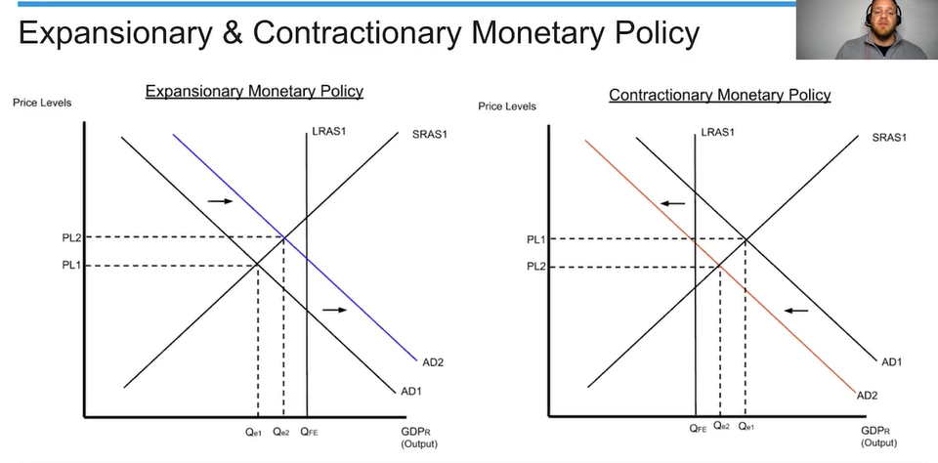
The Effectiveness of Expansionary and Contractionary MP
Note: Expansionary or contractionary monetary policy isn’t necessarily 100% effective. It will help to close the output gap but not necessarily the whole way.

Slide 51
Will monetary policy always be completely effective in closing a macroeconomic output gap?
No.
It will move the economy back closer to Yp but not necessarily be 100% effective.

Slide 52
Money Market Summary
Contractionary Monetary Policy
↓ Money Supply, ↑ Interest Rates
↓C↓I
↓AD
Money Demand (MD)
The demand to hold liquid money (M1).
Reasons: Transactions, to hold as an asset
↑Interest Rate↓Quantity of Money demanded (negative relationship)
Shifters: ∆Price Level, ∆National Income, ∆ Bank Technology, ∆AD
Money Supply (MS)
The supply of money which is controlled by the Federal Reserve which is why it is vertical.
Shifters: Increases or decreases in MS are made by the Fed
Nominal Interest Rate is used in this model
The Money Market is a ‘short term’ market and inflation is not a factor in the short run.
Expansionary Monetary Policy
↑Money Supply, ↓Interest Rates
↑C ↑I
↑AD

Slide 53
Monetary Policy Review
Monetary policy is the other main tool that the government can use to manage the economy. (What was the other one? Fiscal Policy)
Monetary Policy - Changing Interest Rates
We have now seen that MP is the changing of the interest rate by changing the money supply.
Changing the interest rate has the following consequence on the economy.
Investment (I) changes because the cost of borrowing is lower
Consumption (C) changes for interest sensitive products such as houses, cars, college tuition etc.
This leads to an increase or decrease in AD which can help fight a slowing economy which is in a negative output gap.
Fighting Recession / Correcting -ve output Gap
↑ money supply →↓ interest rate → ↑ AD
Note: The effect on the AD is the same as fiscal policy.
Fighting Inflation / Correcting +ve output Gap
Summary
Monetary Policy – ↑↓ money supply to ↓↑ the interest rate.
Expansionary – ↑ AD (correct –ve output gap)
Contractionary – ↓ AD (correct +ve output gap)
↓ money supply → ↑ interest rate → ↓ AD

Slide 54
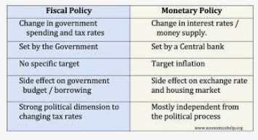
Comparison: Fiscal Policy, Monetary Policy

Slide 55
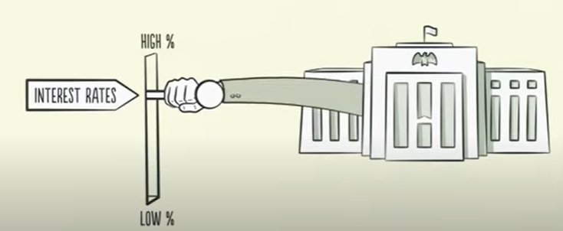
https://youtu.be/PHe0bXAIuk0?t=745
Ray Dalio – Central Bank Increasing Interest Rates vs Inflation

Slide 56
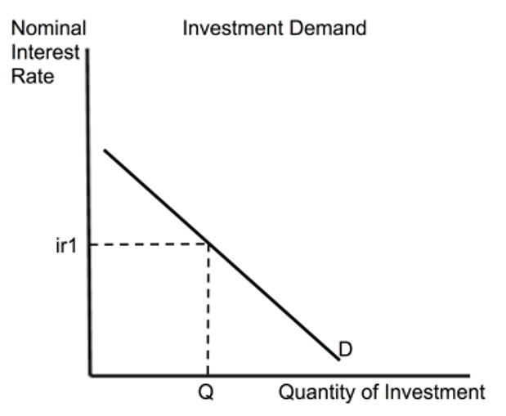
The Investment Curve
Summary
The Investment Curve is the demand of Investment.
It has a negative relationship with nominal interest rate.
It is connected to our study of monetary policy.
The investment curve is not an essential graph to draw, but it does help us to understand the relationship between the interest rate and the amount of investment, I (remember that AD=C+I+G+X-M) in the economy.
The investment curve is really the demand curve for investment.
Therefore, it is downward sloping.
It has an inverse relationship with the interest rate in the economy.
Note: We are using the nominal interest rate, but we could also use the real interest rate because investment is longer term and inflation is therefore relevant.
The Investment Curve and Monetary Policy
We discussed how the change of NIR affects AD.
↑NIR→ ↑cost of borrowing→↓I↓C→↓AD
↓NIR→↑cost of borrowing→↑I↑C→ ↑AD
We can see graphically, how this would affect the investment in the economy.

Slide 57
What happens to the quantity of investment if the nominal interest rate decreases?
The cost of borrowing decreases, which increases the quantity of investment.
Lowering the nominal interest rate is an example of contractionary of expansionary MP?
Expansionary.
What is the effect on AD as a result of this policy?
Increase of AD.

Slide 58
Three Tools of Changing Money Supply for Monetary Policy
We have established that monetary policy is done by changing interest rates, and that this is often done by changing the money supply.
But what methods are used to change the money supply?

Slide 59
Three Tools of Monetary Policy for Changing Money Supply
Summary
There are three methods that the Fed uses to change MS.
How does the Fed increase or decrease money supply?
?
?
?

Slide 60

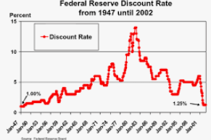

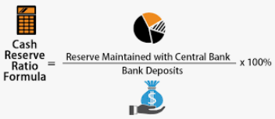
Three Tools of Monetary Policy
How does the government and Fed actually affect implement their policy?
Three Tools of Monetary Policy
Open Market Operations (OMO)
Buying and selling bonds increases/decreases the money supply
Remember: Buy Bonds = Big (increase money supply), Sell Bonds = Small (decrease money supply)
3. Discount Rate
This is directly setting the interest rate that banks pay if they borrow from the Fed. If banks can borrow more cheaply the MS will increase.
2. Required Reserve Ratio (RRR)
Increasing/decreasing RRR allows banks to lend more or less which affects the MS
Required
Securities = bonds
(or any other financial assets)

Slide 61
1. Open Market Operations

Slide 62
Open Market Operations (OMO)
Three Tools of Monetary Policy
Summary
Buy (bonds) = Big, Sell (bonds) = Small
Expansionary:
Buy Bonds → ↑Money Supply → ↓interest rate → ↓Consumption↓Investment ↑ AD
Contractionary:
Sell Bonds → ↓Money Supply → ↑ Interest Rate → ↓Consumption↓Investment ↓AD
The Fed can increase or decrease the money supply by buying or selling bonds. This is the biggest tool that the Fed uses.
If we consider the case of the The Fed buying bonds, this means they are lending money to banks, firms and individuals, which causes an increase in the amount of liquid money in the system.
In the case of selling bonds, the government is taking liquid money from banks, firms and individuals which will reduce the amount of liquid money in the economy.
Buy bonds = increase the money supply → decrease the interest rate → ↑AD
Sell Bonds = decrease the money supply → increase interest rate→ ↓AD
Remember: When the Fed:
Buy Bonds = Big (↑ money supply),
Sell Bonds = Small (↓ money supply)

Slide 63




Buying Bonds vs Selling Bonds
Summary
The Fed buying bonds will increase the monetary base first, then the money supply when banks start to loan.
Money that the Fed holds is not a part of the money supply.
So when the Fed buys they put new money in the money supply and when they sell they take money out of the money supply.
The Fed Buys Bonds
The Fed Sells Bonds
M1 & M2 Money Supply
M1 & M2 Money Supply
Bonds
Bonds
Bonds leave the system and money enters the money supply.
Therefore money supply increases.
Buy = Big
Bonds enter the system and money leaves the money supply.
Therefore money supply decreases.
Sell = Small
Note: The Monetary Base (MB) the first thing to increase when the Fed buys bonds. Once banks start lending, money supply will then increase.

Slide 64
Monetary Base THEN Money Supply
Summary
Monetary base increases first and then the money supply once the banks lend.
The money supply increases as a result of the OMO purchase of bonds by the Fed, however it occurs in a particular order.
1. The money that the Fed uses to buy bonds will first go into the excess reserves of banks.
Because reserves are not part of the money supply, only the monetary base increases at first.
2. However, once the banks start to lend, the money supply will also increase.

Slide 65
Effect of OMO
↓ Money Supply, ↑ Interest Rates
Contractionary Monetary Policy
↓C↓I
Sell Bonds = Money that is in the money supply leaves the money supply
Expansionary Monetary Policy
↑C ↑I
Buy bonds = Money that was NOT in the money supply enters the money supply
↑Money Supply, ↓Interest Rates

Slide 66
What should the government do as contractionary monetary policy, with regards to OMO?
They should sell bonds as this will decrease the money supply and increase the nominal interest, leading to a fall in AD.

Slide 67
2. Required Reserve Ratio

Slide 68
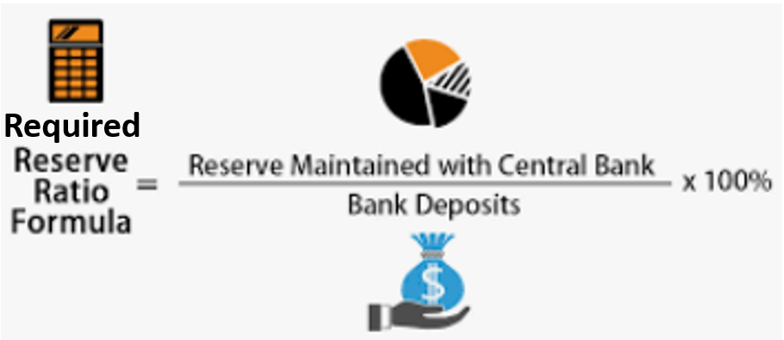
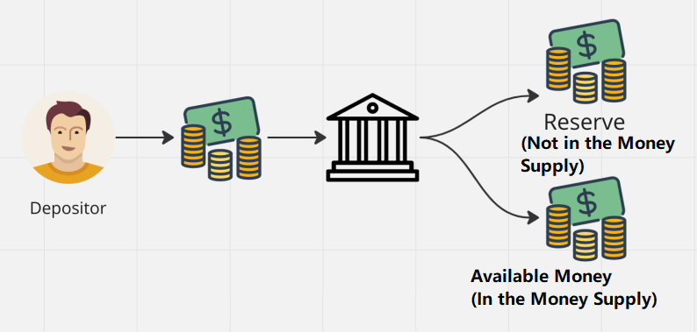

Required Reserve Ratio (RRR)
Three Tools of Monetary Policy
Summary
Expansionary:
↓ RRR → ↑Money available for banks→ ↑Money Supply → ↓interest rate → ↑ Consumption ↑ Investment ↑ AD
Contractionary:
↑ RRR → ↓Money available for banks→ ↓Money Supply → ↑ Interest Rate → ↓Consumption↓Investment ↓AD
The Required Reserve Ratio (RRR) determines how much money banks have available.
The more money the banks have available, the more money is in the money supply.
To Increase the Money Supply
↓ RRR – banks have more money available→ ↑Money Supply
To Decrease the Money Supply
↑ RRR – banks have less money available→ ↓Money Supply

Slide 69
Effect of Changing the RRR
↓ Money Supply, ↑ Interest Rates
Contractionary Monetary Policy
↓C↓I
↑ RRR – banks have less money to lend out →
Expansionary Monetary Policy
↑C ↑I
↓ RRR – banks have more money to lend out →
↑Money Supply, ↓Interest Rates

Slide 70
What happens to the money supply if The Fed increases the RRR?
It will decrease the money supply because there is a decrease in the amount of money that banks have available.
Would this be an example of expansionary or contractionary MP?
Contractionary.

Slide 71
3. Discount Rate

Slide 72
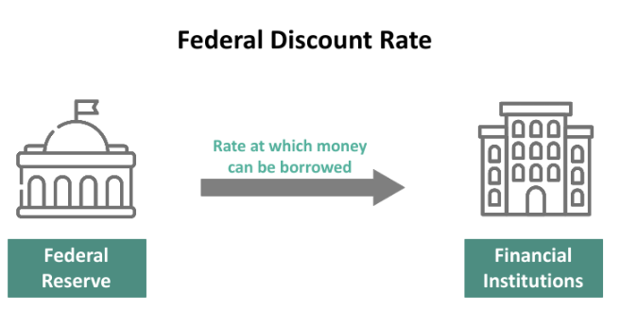

Discount Rate
Three Tools of Monetary Policy
Summary
Expansionary:
↓ Discount Rate → ↑Bank Loans → ↑Money Supply → ↓interest rate → ↑ Consumption ↑ Investment ↑ AD
Contractionary:
↑ Discount Rate → ↓Bank Loans → ↓Money Supply → ↑ Interest Rate → ↓Consumption↓Investment ↓AD
The discount rate is one which the Federal Reserve can set directly which will affect the amount of lending in the economy.
Because this affects lending it will then affect the money supply.
Discount Rate –The rate that the Federal Reserve charges to commercial banks when commercial banks borrow money.
It is called the discount rate, because typically the Federal Reserve will charge commercial banks a lower rate than the market rate, therefore giving commercial banks a ‘discount’.
We will lend to the commercial banks and charge a very reasonable interest rate.
When the Fed lowers the discount rate, we should borrow more.
Increase in the Discount Rate
Cost of borrowing from the Fed to increase, banks borrow less from the Fed and have less money available to lend → ↓Money Supply
Decrease in the Discount Rate
Cost of borrowing to decrease, banks borrow more from the Fed and have more money to lend out → ↑Money Supply

Slide 73
Effect of Changing the Discount Rate/Policy Rate
↓ Money Supply, ↑ Interest Rates
Contractionary Monetary Policy
↓C↓I
↑Discount Rate ↑ – commercial banks pay more to borrow money from the Fed and will borrow less, therefore, have less money to lend out →
Expansionary Monetary Policy
↑C ↑I
↓Discount Rate or Policy Rate
commercial banks pay less to borrow money from the Fed and will borrow less, therefore, have more money to lend out →
↑Money Supply, ↓Interest Rates

Slide 74
What is the name of the interest rate that the Fed charges to commercial banks when it lends to them?
The Discount Rate
What effect would an increase in the discount rate have on the MS?
Commercial banks will borrow less from the Fed and have less to lend themselves. Therefore, decrease of the MS.
Would this be an example of expansionary or contractionary MP?
Contractionary.

Slide 75
What are the three tools of monetary policy? Explain what would be done for expansionary monetary for each tool.
OMO – Open Market Operations
Federal Reserve should buy bonds, increasing the money supply.
Required Reserve Ratio
Federal Reserve should lower the RRR, increasing total loans and increasing money supply
Discount Rate
Federal Reserve should lower the discount rate to encourage more lending, increasing money supply.

Slide 76
Three Tools of Changing Money Supply for Monetary Policy
How does the government and Fed actually affect implement their policy?
Three Tools of Monetary Policy
Open Market Operations (OMO)
Buy bonds = increase the money supply -> decrease the interest rate
Sell Bonds = decrease the money supply -> increase interest rate
Remember: Buy Bonds = Big (increase money supply), Sell Bonds = Small (decrease money supply)
3. Discount Rate
Increase Discount Rate – decrease the money supply -> increase interest rate
Decrease Discount Rate – increase the money supply -> decrease interest rate
2. Required Reserve Ratio (RRR)
Incr1q]]\ease RRR – decrease the money supply -> increase interest rate
Decrease RRR – increase the money supply -> decrease the interest rate
Required
Securities = bonds
(or any other financial assets)

Slide 77
Monetary Policy Tools Summary
↓ Money Supply, ↑ Interest Rates
Contractionary Monetary Policy
Contractionary Monetary Policy Tools
Open Market Operations (OMO) – Sell bonds → money leaves money supply →
↑ Required Reserve Ratio → Less money available for borrowing/lending →
↑Discount Rate → ↑ Cost of borrowing → ↓Bank borrowing/lending →
↓C↓I
Expansionary Monetary Policy
↑C ↑I
Expansionary Monetary Policy Tools
OMO – Buy Bonds → new money enters money supply →
↓Required Reserve Ratio→ More money available for borrowing/lending →
↓Discount Rate → ↓Cost of borrowing → ↑ Bank borrowing/lending →
↑Money Supply, ↓Interest Rates

Slide 78
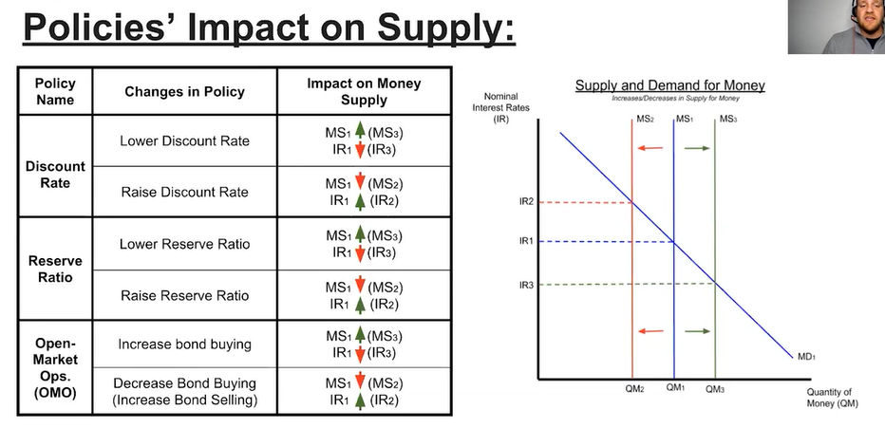

College Board Monetary Policy Tools Summary

